Slide 1


Slide 2
Exercise 1 - Program Intentions
Course Intentions Outline up to three goals for the course (what you would like to learn/gain/become) | Personal Commitments Outline up to three commitments you will make to yourself to ensure you achieve your goals

Slide 3
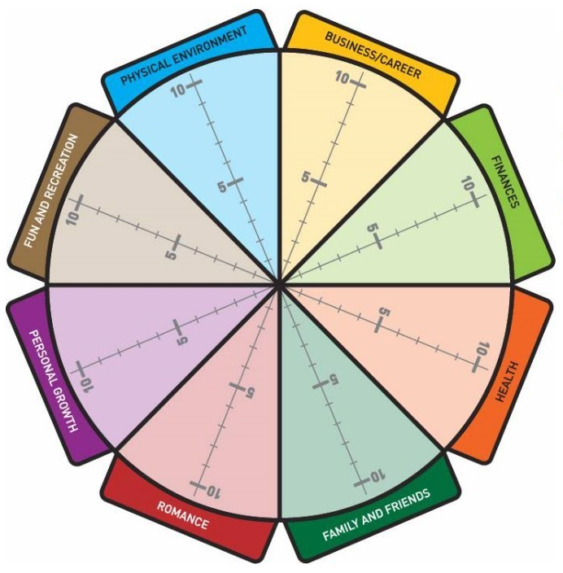
Exercise 2 - Self Assessment
Scale of 0 (low) – to 10 (high)
1.0 Revise any of the 8 labels to better reflect the categories of your life and work.
2.0 On the left part of each triangle, assess your level of satisfaction of this part of your life.
3.0 On the right part of each triangle assess your level of attention to this part of your life.
4.0 Next to each section rate from the importance this area is to you.
5.0 What are your observations from this exercise?
______________________________________________
______________________________________________
￼

Slide 4
Exercise 3 - Journaling
What’s going on in your life? What changes are happening? How is this affecting your life?
___________________________________________________________________________________________________________
How are you feeling about the changes?
___________________________________________________________________________________________________________
What could the current changes in your life be teaching you or leading you toward?
___________________________________________________________________________________________________________
What are your main goals in your life and work?
___________________________________________________________________________________________________________
￼

Slide 5
Exercise 4 - Alignment
What does alignment feel like to you? When are you most aligned? | What does mis-alignment feel like to you? When are you most out of alignment?

Slide 6
Exercise 5 - Purpose
What does Purpose mean to you? Why is Purpose important in your life? | How do you experience Purpose/meaning in your work/in your home life? What would help you to feel more Purpose/meaning?

Slide 7
Exercise 6 - Review Module #1
Write down any observations, insights ah ha’s that you may have experienced during this module.
￼

