Slide 1
Module: Manifest
 |  | Career / Profession | Business / Not for Profit | Retirement / Volunteer
1 | Determine Your Authentic Brand | Personal Brand | Business Brand | Personal Brand
2 | Identify Your Offering & Pricing | Position, skills, salary, | Products/services, bundles and pricing | Time, skills, know-how
3 | Developing Your Community | Employers, peers, stakeholders | Prospects, clients, collaborators, stakeholders | Stakeholders, collaborators
4 | Training, Systems and Process | Personal requirements | Business requirements | Personal requirements
5 | 90 Day Action Plan
6 | Measurement
7 | Review Module

Slide 2

Exercise 1.0 - Branding Checklist
Next Steps
1. Unique Selling Proposition
  Have you researched the market?
  Do you know your competitive advantage?
  Have you defined your USP?
2. Brand Messaging:
  Can you articulate the problem you solve?
  Can you list the features of working with you?
  Can you list the benefits of working with you?
  Do you have a 30 sec pitch?
  Do you need a revised CV/Bio?
3. Brand Image
  Have you selected your preferred font?
  Have you selected your colour palette?
  Have you selected images that represent your brand?

Slide 3
Exercise 2.0 - Offering Checklist
1. Career / Profession
  Have you identified the types of positions you would like to hold?
  What are the regular titles that are used for these positions?
  Can you identify the skills you will need (that you have and/or will need to develop?
  Do you know what you can expect as a reasonable salary, benefits?
2. Business / Not for Profit:
  Do you have a product or service, signature program?
  Does it fit an unmet need in the market?
  Do you have a pricing strategy?
  Have you chosen Sales channels, or will you be selling directly?
3. Retirement / Volunteer
  How much time would you like to dedicate, when?
  What kind of skills or know-how would you like to share?
  What kind of causes match your vision?
Next Steps

Slide 4
Exercise 3.0 - Community Checklist
Next Steps
1. Career / Profession /Retirement / Volunteer
  Do you have an online presence that matches your desired career vision?
  Do you need a website?
  What social media platform (s) do you need?
  Do you have a networking strategy?
2. Business / Not for Profit:
  Do you have an online presence, a website?
  What social media platform (s) do you need?
  Do you have a client database?
  Do you have an email service set up?
  Do you have a marketing and sales strategy?

Slide 5
Exercise 4.0 - Training, Systems & Process Checklist
1. Training and Development
  What steps do you need to take to start the development process rolling?
  How will you stay committed?
2. Process:
  What steps do you need to take to start making changes or adding new process to your work?
  How will you stay committed to the new process (es)?
3. Systems
  What steps do you need to take to start making changes or adding new systems to your work?
  How will you stay committed to the new system (es)?
 | Next Steps
Training and Development
New Processes
New Systems

Slide 6
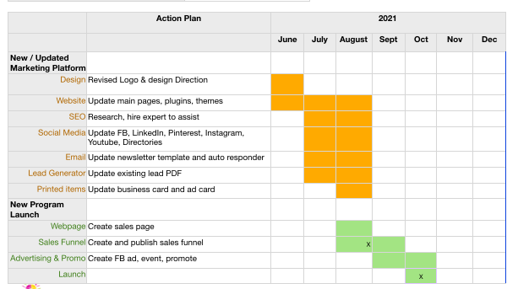
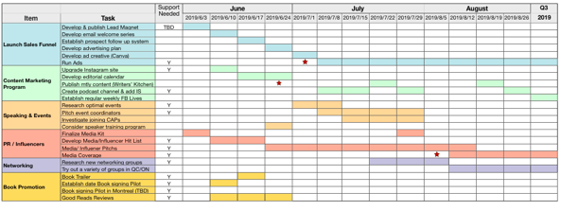
90 Day Rolling Plan
12 - 18 month high level plan
Break down your larger plan into a smaller schedule
Rolling means that you add a month when one finishes so you are always looking at the next 3 months
This is an actionable schedule
It has clear deliverables
Realistic timelines
You can then break the 90 Day plan into weekly plans
90 Day Rolling detailed plan

Slide 7
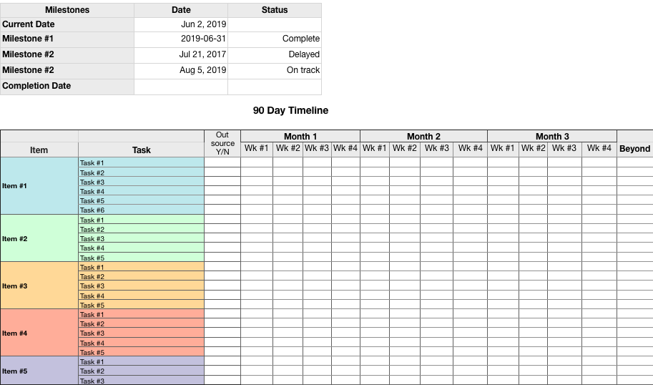
Exercise 6.0 - 90 Day Plan

Slide 8
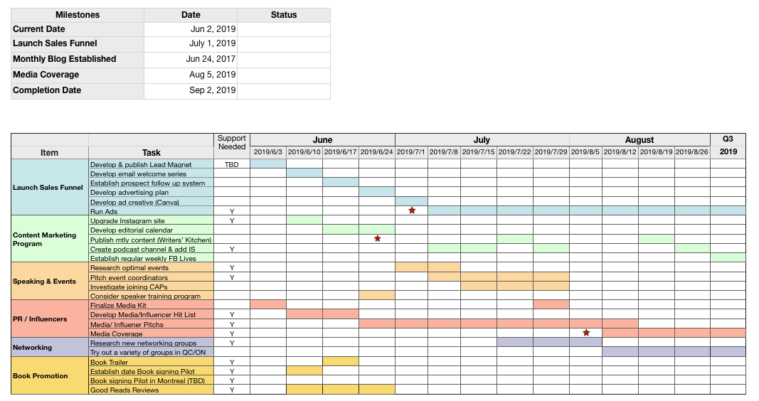
Exercise 6.0 - 90 Day Plan - Example

Slide 9
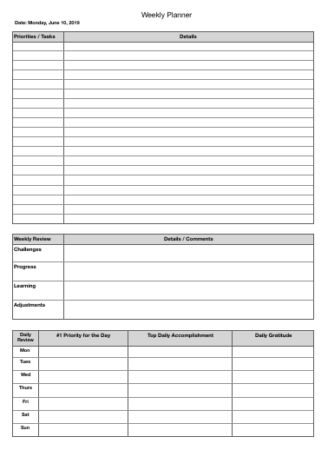
Exercise 6.1 - Weekly Planner
Translate 90 Day plan into weekly objectives
Track your progress and challenges

Slide 10
Exercise 7.0. Sustaining Success
What does success look like to you? How will you quantify it?
How will you measure and track results?
How often will you measure and analyze results?
Do you have a contingency plan? Other ideas to test?
What do you believe will be your key success factors (KSF’s)?

Slide 11
Exercise 7.0. Sustaining Success - Example
What does success look like to you? How will you quantify it?
How will you measure and track results?
How often will you measure and analyze results?
Do you have a contingency plan? Other ideas to test?
What do you believe will be your key success factors (KSF’s)?
20 good prospects and 5 new clients (4 group, 1 private) per month
Steady revenue flow of $x per month
Addition day per week to focus on growing business
Email list and social media follower growth
Number of new inquiries
# of speaking, networking and media interviews
Monthly
Develop plan to target corporate market
Staying focused and on track
Gaining speaking, networking, media interviews to expand network’
Completing and testing new Sales funnel

Slide 12
Review Module
Write down any observations, insights ah ha’s that you may have experienced during this module.
________________________________________________________________________
___________________________________________________________________
___________________________________________________________________
________________________________________________________________________
________________________________________________________________________
___________________________________________________________________

